Slide 1
Literature Survey

Slide 2
Just a joke? A Social impact of Internet memes
Source: https://www.researchgate.net/publication/341738736_Just_a_Joke_The_Social_Impact_of_Internet_Memes
Date of publish: April,2020
Highlights:
The term 'meme' was coined by Richard Dawkins in 1976 to describe small units of culture that spread from person to person by copying or imitation”.
Whitney Phillips's This Is Why We Can't Have Nice Things is a book about the complexities of online communities, hate, and freedom of speech. Phillips discusses the act of Internet “trolling” – pranking, unsuspecting targets for personal entertainment.
The Internet allows people to become both authors and consumers with extreme ease.
The ability to publish anything, unfiltered, has generated an interesting tapestry of content. Any person with Internet access can post their thoughts online.
“[Digital media] make it possible for the first time in history to produce, edit, process, store, copy, distribute, and retrieve knowledge [using a single] technical medium.”9 With these new advantages, the meme found a space to thrive: the Internet.
Phillips notes, “trolls are widely regarded as the primary obstacle to a kinder, gentler, and more equitable Internet”. As increasing numbers of people share content every day, the amount of imagery online is expanding. Users can customize memes to suit their own interests. This means that the same meme, once altered, can be shared across a range of web communities. With the Internet so socially divided ,thus quality is extremely important.
Memes to Process Trauma.

Slide 3

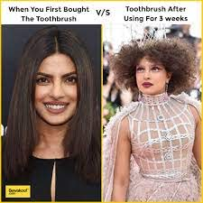
Hateful Memes
vs
Non Hateful Memes
Hateful Memes

Slide 4
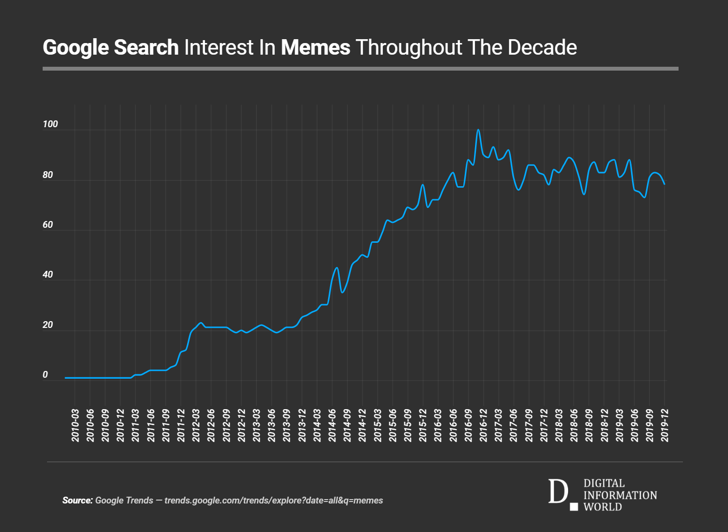
Rise of memes

Slide 5
Datasets Available

Slide 6
Works done :
Reference Paper 1 : “Multimodal Hate Speech Detection in Memes.”
Author: Benet Oriol Sabat
Credential : Universitat Plitechnica De Catalunya.
Publication : Universitat Polit`ecnica de Catalunya (UPC) 2019
Work Summary : This thesis explores a multimodal approach to Hate Speech detection, involving vision and language (text). More specifically, we deal with the context of memes, a form of internet humour which will present additional challenges. Also study different ways to fine-tune pretrained descriptors for their specific task.

Slide 7
Introduction :
Memes are a form of humorist content which is normally based on an image, and most of the time some sort of text such as a caption.
This format has also been used to produce hate speech in the form of dark humour.
The multimodal (combined) analysis of image and text for hate speech has been a limitedly explored task, and can be used to tackle the hate memes problem.
Purpose :
To create a tool to automatically predict hate speech on memes, using both image and text modalities.
Specifications :
Pytorch API as the basic deep learning framework for development
Python language.

Slide 8
Methods :
Pretrained embedding for text and images and train a classifier with these embeddings
Implementations of BERT and VGG-16 features.
Hate speech detection :
Dataset :
Memes from Google images.(Hate memes.)
racist meme, jew meme, muslim meme.
2. Memes from Reddit Memes dataset(Non-Hateful Memes)
Architecture :
Using OCR – Extract the text of the image(pytesseract)
Text Embeddings – BERT (bert-base-multilingual-cased.)
Image Embeddings – VGG-16 (Pre-trained on ImageNet)

Slide 9
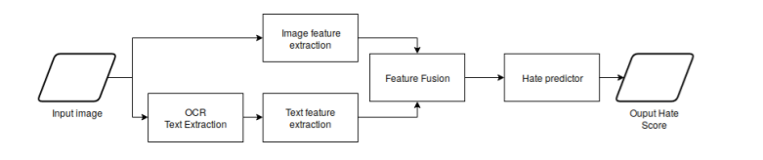
Fusion and the classifier -

Slide 10
Experiments :
Text descriptors : VGG-16 and BERT
Classifier : A Multi-Layer Perceptron (MLP) with two Hidden Layers, Hidden size = 100
Optimizer: SGD with momentum, learning rate = 0.01, momentum = 0.9, Batch size = 30.
Result : Large loss functions.
Optimizer : Adam with β1 = 0.9 and β2 = 0.999.
Improved accuracy (84%)
Possible Other Descriptor : XLNET model which has been proved to outperform BERT.

Slide 11
Conclusion : The quality of the annotations was very bad, and this has probably been one of the main limitation of the project and reasons to get much worse training and evaluation of the model.

Slide 12
Reference Paper 2 : “VISUALBERT: A SIMPLE AND PERFORMANT BASELINE FOR VISION AND LANGUAGE”
Authors: Liunian Harold Li, Mark Yatskar, Da Yin , Cho-Jui Hsieh & Kai-Wei Chang
Credential: University of California, Los Angeles, Allen Institute for Artificial Intelligence, Peking University.
Work Summary : They propose VisualBERT, a simple and flexible framework for modeling a broad range of vision-and-language tasks.
Further they propose two visually-grounded language model objectives for pre-training VisualBERT on image caption data.

Slide 13
Introduction :
VisualBERT, a simple and flexible model designed for capturing rich semantics in the image and associated text.
1. VisualBERT : Integration of “BERT” a recent Transformer-based model for natural language processing, and pretrained object proposals systems such as “Faster-RCNN”.
2. In particular, image features extracted from object proposals are treated as unordered input tokens and fed into VisualBERT along with text. The text and image inputs are “jointly processed” by multiple Transformer layers in VisualBERT. The rich interaction among words and object proposals allows the model to capture the intricate associations between text and image.
3. Pre-training VisualBERT on image caption data(COCO), where detailed semantics of an image are expressed in natural language.
Two Reasons for pre-training:
Part of the text is masked and the model learns to predict the masked words based on the remaining text and visual context;
The model is trained to determine whether the provided text matches the image.
This shows that such pre-training on image caption data is important for VisualBERT to learn transferable text and visual representations.
Additionally,
VisualBERT learns to ground entities and encode certain dependency relationships between words and image regions, which helps model understand the detailed semantics of an image . In VisualBERT, the self-attention mechanism allows the model to capture the implicit relations between objects.
Furthermore, pre-training on image caption data is an effective way to teach the model how to capture such relations.

Slide 14
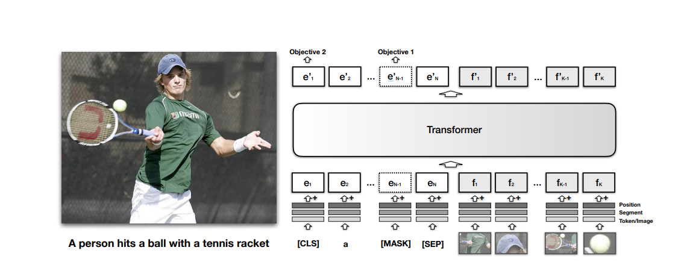

Slide 15
Training VisualBERT :
Procedure :
1. Task-Agnostic Pre-Training :
Train VisualBERT: Using COCO image caption dataset using two visually-grounded language model objectives.
Masked language modeling with the image. Some elements of text input are masked and must be predicted but vectors corresponding to image regions are not masked.
Sentence-image prediction: For COCO, where there are multiple captions corresponding to one image, we provide a text segment consisting of two captions. One of the caption is describing the image, while the other has a 50% chance to be another corresponding caption and a 50% chance to be a randomly drawn caption. The model is trained to distinguish these two situations.
2. Task-Specific Pre-Training : Before fine-tuning VisualBERT to a downstream task, they find it beneficial to train the model using the data of the task with the masked language modeling with the image objective. This step allows the model to adapt to the new target domain.
3. Fine-Tuning : This step mirrors BERT fine-tuning, where a task-specific input, output, and objective are introduced, and the Transformer is trained to maximize performance on the task.

Slide 16
Experiment :
Evaluation of VisualBERT on two different types of vision-and-language applications :
Visual Question Answering (VQA 2.0)
Visual Commonsense Reasoning (VCR)
Optimizer for all Models : SGD with Adam.
VisualBERT: The full model with parameter initialization from BERT that undergoes pre-training on COCO, pre-training on the task data, and fine-tuning for the task.
VisualBERT w/o Early Fusion: VisualBERT but where image representations are not combined with the text in the initial Transformer layer but instead at the very end with a new Transformer layer. This allows us to test whether interaction between language and vision throughout the whole Transformer stack is important to performance.
VisualBERT w/o COCO Pre-training: VisualBERT but where they skip task-agnostic pre-training on COCO captions. This allows to validate the importance of this step.

Slide 17
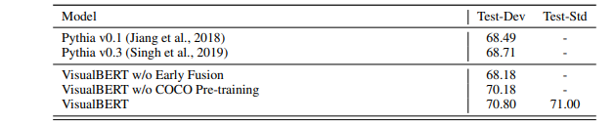
1. VQA :
Dataset : VQA (2.0) :
COCO images (all of current train/val/test), Questions ,ground truth answers
Training : Faster RCNN for image features.
Model Performance :

Slide 18
2. VCR :
Dataset : VCR
objects: a list of objects detected, for instance, ["person", "person", "horse", "horse", "horse", "horse"]
img_fn: the filename of the image, within the vcr1images directory.
metadata_fn: the json metadata file for the image, within the vcr1images directory.
question: Tokenized version of the question. Detection tags are represented as lists, so one example might be ["What", "are", [0,1], "doing", "?"] which corresponds to What are 0 and 1 doing?, where 0 and 1 are indexes (starting at 0) into objects.
answer_choices: A list of four answer choices, with the same format as question.
answer_label: Which answer (0 to 3) is right in answer_choices.

Slide 19
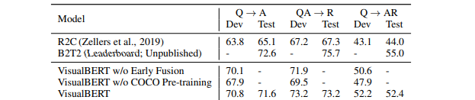
Model Performance :
Conclusion : Despite VisualBERT is simple, it achieves strong performance on these above evaluation tasks.

